Slide 1
Sample Slide Preparation Guide for Xenium Assays
Light Microscopy Imaging Core (LMIC) / CWRU
Robbins building, 6th Floor, Rm. E-632
somlmic@case.edu / somlmic.com
August, 2024

Slide 2
Xenium: FFPE Samples
Blocks should be fixed in 10% neutral-buffered formalin (fixative to tissue ratio of 20:1) for 16-24h at 4C
FFPE blocks should be stored at 4C
Sections should be 5um thickness
Avoid any scratches and folds in the tissue section → potential tissue loss
Always discard the first few sections from block face
Sections should be mounted in the center of slide (within the scan area)
Proceed immediately from fixation to dehydration, clearing, and embedding. If proceeding to dehydration immediately is not possible, transfer tissue from fixative to 70% ethanol for short-term storage
Xenium slides containing tissue sections that have been incubated at 42C for 3h and dried overnight at RT in a desiccator can be stored for up to 4 weeks at RT in a desiccator
For a detailed manual for FFPE sample preparation:
Xenium In Situ for FFPE – Tissue Preparation Guide (manual #CG000578 Rev D, June 2024): Xenium In Situ for FFPE - Tissue Preparation Guide - Official 10x Genomics Support

Slide 3
Xenium: Fresh Frozen (FF) Samples
Use a bath of isopentane on dry ice to freeze the freshly obtained tissue
Tissue should not be placed directly in liquid nitrogen as the temperature difference may cause boiling on the surface of the tissues, leading to air pockets and uneven freezing → this may crack and morphologically damage the tissue
Frozen tissues should be embedded in OCT before sectioning → store at -80C in a sealed container
It is critical to avoid any scratches and folds in the tissue section → potential tissue loss
Sections should be cut at 10 um thickness → mount immediately on slides
Cryostat temp. should be set to -20C → always keep Xenium slides at -20C
After sectioning, the exposed block face should be covered with OCT
Slides containing tissue sections are stored in a slide mailer at -80C for up to 4 weeks after sectioning
For a detailed manual for FF sample preparation:
Xenium In Situ for Fresh Frozen Tissues - Tissue Preparation Guide (manual #CG000579 Rev D, June 2024): Xenium In Situ for Fresh Frozen Tissues - Tissue Preparation Guide - Official 10x Genomics Support

Slide 4
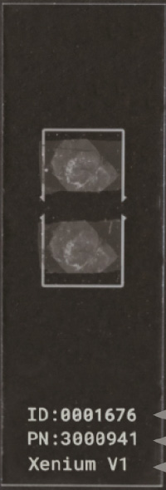
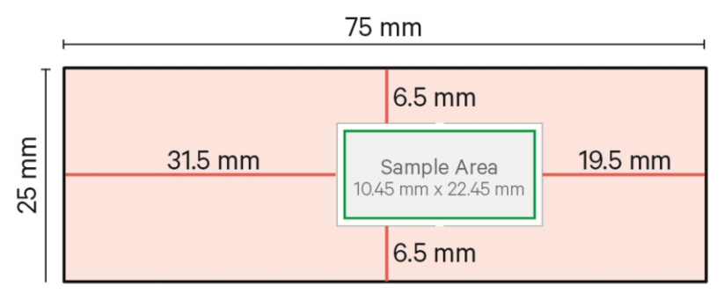
Xenium: Slides for Users
Scan (sample) Area
Tissue sections should be at 5 um (FFPE) or 10 um (FF) thickness.
Users will be provided with empty slides marked with the area for section mounting. Tissue sections should be mounted within the blue box. Only this area will be scanned by the instrument. Any excess tissue extending out of the scan area will block fiducials and result in run failure.
Users should make sure tissue sections are well adhered to the slides.
Once sections are placed on Xenium slides, they cannot be repositioned as this would compromise slide integrity.
User Slide
ID: _______
PN: _______
Xenium In Situ for FFPE – Tissue Preparation Guide
(manual #CG000578 Rev D, June 2024)

Slide 5
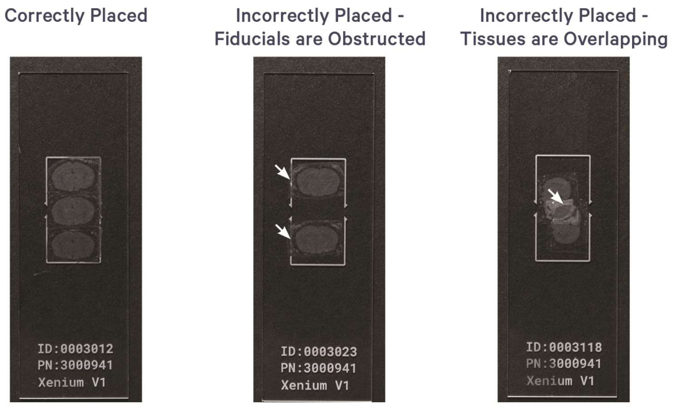
Xenium: Examples of Tissue Placement
Xenium In Situ for FFPE – Tissue Preparation Guide
(manual #CG000578 Rev D, June 2024)
Xenium In Situ for FF – Tissue Preparation Guide
(manual #CG000579 Rev D, June 2024)

