Slide 1
Sample Slide Preparation Guide for CosMx Assays
Light Microscopy Imaging Core (LMIC) / CWRU
Robbins building, 6th Floor, Rm. E-632
somlmic@case.edu / somlmic.com
March, 2024

Slide 2
CosMx: Selecting FFPE Blocks
Blocks should be fixed in 10% neutral-buffered formalin for 18-24h at RT (5um thick tissues)
Tissues should be fixed immediately after excision for best results. Up to 1h post-excision is acceptable.
Tissues should be thoroughly dehydrated in ethanol gradients prior to embedding in paraffin
FFPE blocks should be stored at RT and ambient humidity
Do NOT use FFPE blocks older than 10 years
For a detailed manual, refer to:
CosMx SMI Manual Slide Preparation for RNA Assays (MAN-10184-02, Feb. 2024): https://university.nanostring.com/cosmx-smi-manual-slide-prep-for-rna-assays

Slide 3
CosMx: Sectioning FFPE Blocks
Avoid any scratches and folds in the tissue section → potential tissue loss
Sections should be 5um thickness
Always discard the first few sections from block face
Sections should be mounted in the center of slide (within the scan area)
If mounting multiple sections per slide, ensure that all tissues are at least 2-3mm apart and still contained within the scan area
Any water trapped under wax or tissue section should be removed by gently touching a folded Kimwipe onto corner of the wax section → Kimwipe should not touch the tissue
To improve tissue adherence, bake slides at 37C for 2 hours post-sectioning. After baking, dry at room temperature overnight prior to storage.
Use mounted sections within 2 weeks for best results
Store dried slides at RT in a desiccator or at 4C prior to processing

Slide 4
CosMx: Selecting Fresh Frozen (FF) Blocks
Select tissues that have been snap frozen in liquid nitrogen as quickly as possible
Any buffers used to wash or temporarily store tissues before fixation should be free of nuclease contamination
Frozen tissues should be embedded in OCT before sectioning
Store blocks embedded in OCT at -80C
For a detailed manual, refer to:
CosMx SMI Manual Slide Preparation for RNA Assays (MAN-10184-02, Feb. 2024): https://university.nanostring.com/cosmx-smi-manual-slide-prep-for-rna-assays

Slide 5
CosMx: Sectioning Fresh Frozen (FF) Blocks
It is critical to avoid any scratches and folds in the tissue section → potential tissue loss
Sections should be cut at 10 um thickness → mount immediately on slides
Cryostat temp. should be set to -20C. Place fresh frozen block inside cryostat for a min. of 30 min.
Sections should be mounted in the center of slide (within the scan area)
Always discard the first section from block face
After sectioning, the exposed block face should be covered with OCT to avoid desiccation of the sample
Dry slides at RT for 5-10 min. → store at -80C with a desiccant
Slides can be stored at -80C for several weeks before use

Slide 6
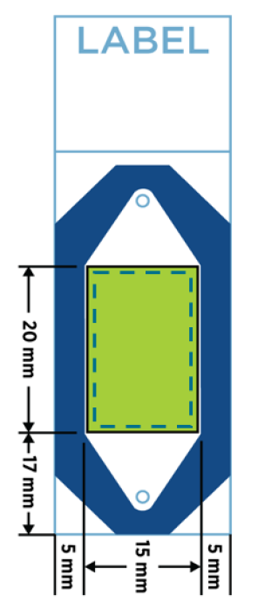
CosMx: Slides for Users
Users will be provided with empty slides marked with the area for section mounting (indicated in black marker).
Tissue sections should be at 5 um (FFPE) or 10 um (FF) thickness.
Tissue sections should be mounted within the blue dotted line. Only this area will be scanned by the instrument.
It is acceptable for tissue section to be larger than the scan area. Any excess tissue extending out of the scan area will be trimmed later in the process.
Users should make sure tissue sections are well adhered to the slides.
Scan
Area
Not to scale
CosMx SMI Manual Slide Preparation for RNA Assays:
MAN-10184-02, Feb. 2024

Slide 7
CosMx: Examples of Tissue Placement
All 3 examples are acceptable:
Slide 1: optimal tissue placement
Slide 2: good tissue placement
Slide 3: needs trimming during processing (performed by the Core)
Slide 1 Slide 2 Slide 3
CosMx SMI Manual Slide Preparation for RNA Assays:
MAN-10184-02, Feb. 2024

